Slide 1
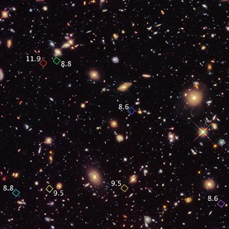
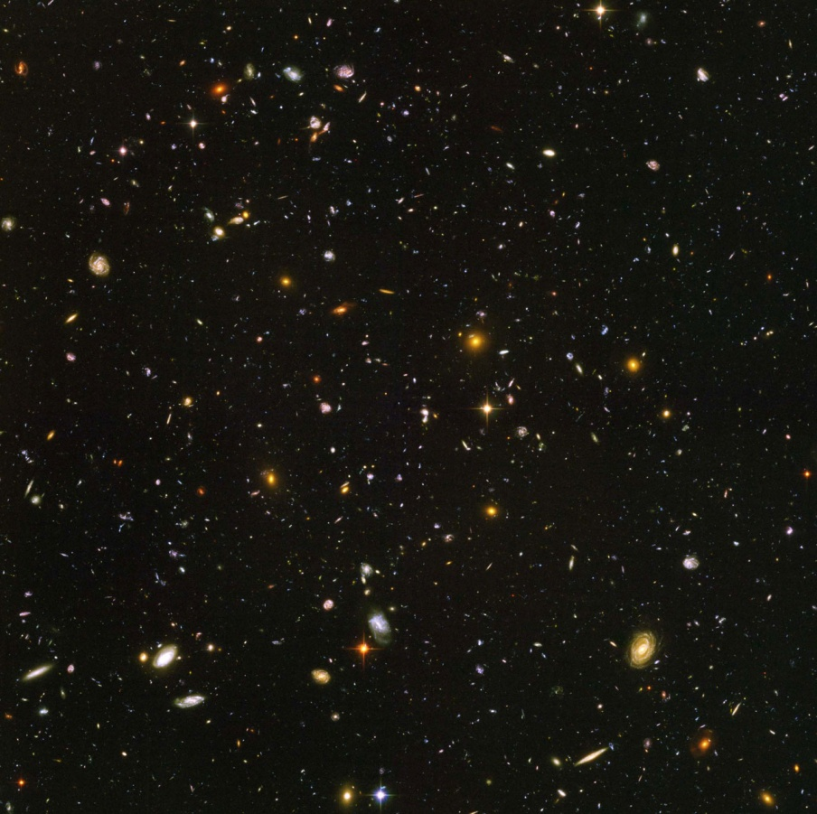
The Deep Survey

Slide 2
What has been gained from the wide survey?
Find galaxies at low redshift
Will identify gravitational lenses
Identify foreground contaminants

Slide 3
Deep survey
Will be able to view high redshift galaxies
Look more closely at candidates
Confirm by detecting in multiple bands

Slide 4
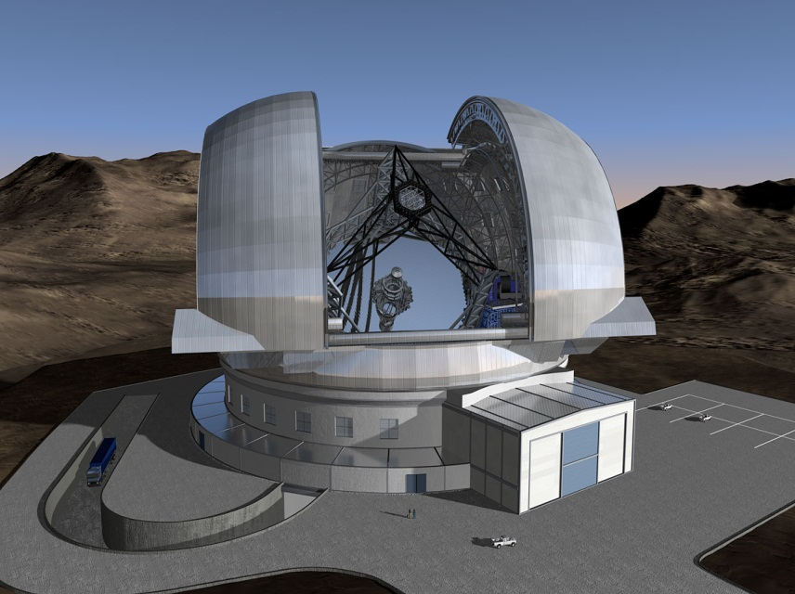
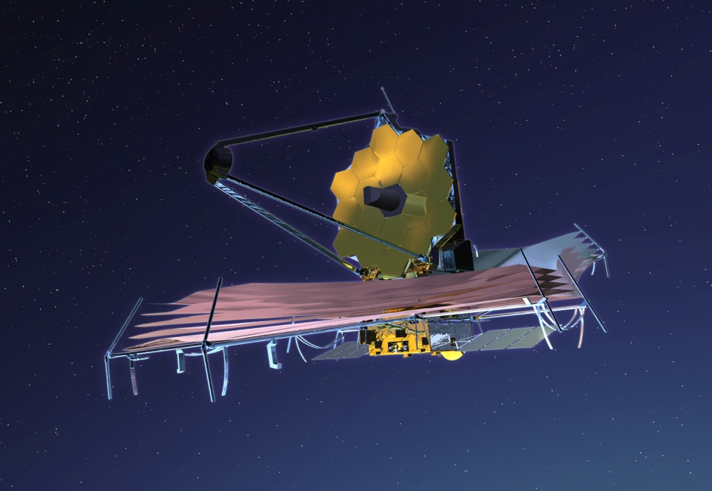
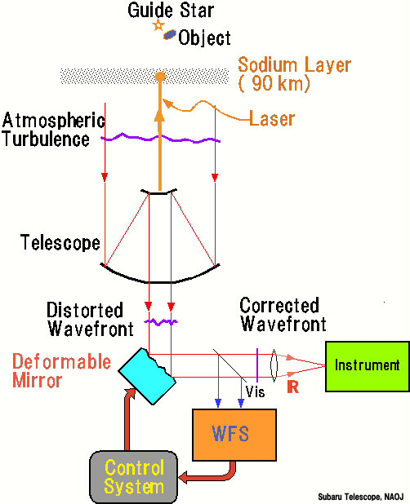
E-ELT
JWST
VS
Adaptive optics

Slide 5

Calculating Observation Times
Euclid | Photons |  | 0.13 | 0.02
 | a |  | 0.02 | 0.00
 | b |  | -355.45 | -343.91
 | c |  | -929710.36 | -929710.36
 | Time (Seconds) |  | 22529.38 | 1152557.36
 | Time (Hours) |  | 6.26 | 320.15
 | # of Exposures |  | 1.84E-02 | 1.52E-01
E-ELT | Photons |  | 52.32 | 6.82
 | Time (Seconds) |  | 19165.65 | 1128378.67
 | Time (hours) |  | 5.32 | 313.44
 | # of Exposures |  | 36.82 | 1775.80
JWST | Filter |  | 0.151 | 0.5
 | Photons |  | 0.81 | 0.35
 | a |  | 0.66 | 0.12
 | b |  | -786.13 | -739.92
 | c |  | -3064501.29 | -3064501.29
 | Time (seconds) |  | 2828.61 | 8830.70
 | Time (Hours) |  | 0.79 | 2.45
Overheads: Readout Time
Transmission
Cosmic Rays
Changing Filters

